Slide 1
Diagnosis flow for each care-seeking visit

Slide 2
Data/assumptions
To estimate
Diagnosis accuracy (from WHO)
CXR sensitivity/specificity: 85% / 96%
Microscopy sensitivity/specificity: 64% / 98%
NAAT sensitivity/specificity: 85% / 98%
NAAT for SS- sensitivity/specificity: 67% / 98%
Calibration targets
Nikshay
Case notification by Bac/CDx and Pub/Eng
Tested presumptive TB by SSM/NAAT
Treatment initiation by Pub/Eng
Drug sale for private anti-TB treatment
Availability of SSM for public pathways
Availability of NAAT for public and engaged private pathways
Sensitivity / Specificity of clinical diagnosis
Proportion of people with actual TB among all tested
Care-seeking preference (public/private)
PPM (patient-centred)

Slide 3
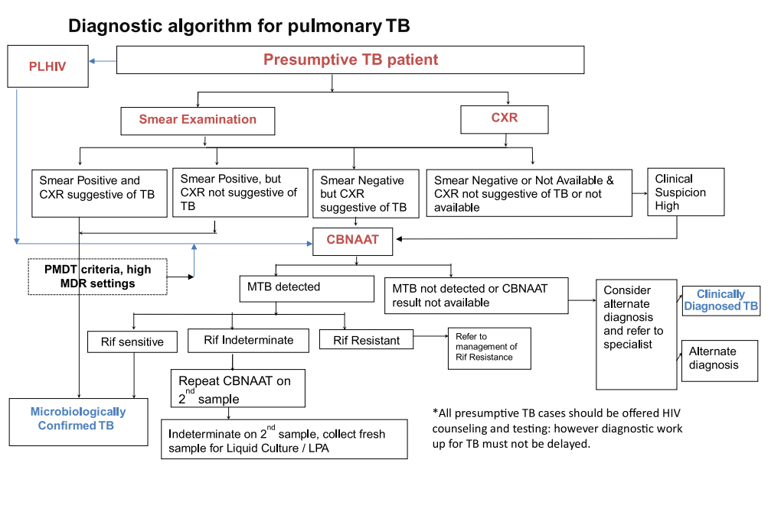
Diagnostic algorithm From the India official guideline

Slide 4
Diagnostic algorithm Simplified
Presumptive TB patient
Assumptions
HIV and DR neglectable
No alternative diagnosis
Smear examination
Smear positive
Smear negative / results not available
CBNAAT
MTB detected
MTB not detected / results not available
Clinical diagnosis
Highly suggestive
else
Microbiologically Confirmed TB
Clinically Diagnosed TB

Slide 5
Diagnostic algorithm Pathway 1, SSM>NAAT>CDx: SSM/NAAT utilised
Presumptive TB patient
Assumptions
HIV and DR neglectable
No alternative diagnosis
Smear examination
Smear positive
Smear negative / results not available
CBNAAT
MTB detected
MTB not detected / results not available
Clinical diagnosis
Highly suggestive
else
Microbiologically Confirmed TB
Clinically Diagnosed TB

Slide 6
Diagnostic algorithm Pathway 2, SSM>CDx: SSM utilised without NAAT
Presumptive TB patient
Assumptions
HIV and DR neglectable
No alternative diagnosis
Smear examination
Smear positive
Smear negative / results not available
MTB not detected / results not available
Clinical diagnosis
Highly suggestive
else
Microbiologically Confirmed TB
Clinically Diagnosed TB

Slide 7
Diagnostic algorithm Pathway 3, NAAT>CDx: NAAT utilised without SSM
Presumptive TB patient
Assumptions
HIV and DR neglectable
No alternative diagnosis
Smear examination
Smear positive
Smear negative / results not available
CBNAAT
MTB detected
MTB not detected / results not available
Clinical diagnosis
Highly suggestive
else
Microbiologically Confirmed TB
Clinically Diagnosed TB

Slide 8
Diagnostic algorithm Pathway 4, CDx only: no microbiological test utilised
Presumptive TB patient
Assumptions
HIV and DR neglectable
No alternative diagnosis
Smear examination
Smear positive
Smear negative / results not available
CBNAAT
MTB detected
MTB not detected / results not available
Clinical diagnosis
Highly suggestive
else
Microbiologically Confirmed TB
Clinically Diagnosed TB

Slide 9
Diagnostic algorithm Overall case detection by pathways
Pathway | True status | Bac+ | CDx+ | Negative | Pre-Dx LTFU
P1: SSM > NAAT > CDx | TB | 74% | 19% | 3% | 4%
 | Non-TB | 3% | 1% | 81% | 15%
P2: SSM > CDx | TB | 54% | 33% | 9% | 4%
 | Non-TB | 2% | 1% | 82% | 15%
P3: NAAT > CDx | TB | 72% | 20% | 4% | 4%
 | Non-TB | 2% | 1% | 82% | 15%
P4: CDx | TB | 0% | 71% | 29% | 0%
 | Non-TB | 0% | 1% | 99% | 0%

Slide 10
Diagnostic algorithm Public case detection by pathways
Pathway | True status | Bac+ | CDx+ | Negative | Pre-Dx LTFU
P1: SSM > NAAT > CDx | TB | 74% | 19% | 3% | 4%
 | Non-TB | 3% | 1% | 81% | 15%
P2: SSM > CDx | TB | 54% | 33% | 9% | 4%
 | Non-TB | 2% | 1% | 82% | 15%
P3: NAAT > CDx | TB | 72% | 20% | 4% | 4%
 | Non-TB | 2% | 1% | 82% | 15%
P4: CDx | TB | 0% | 71% | 29% | 0%
 | Non-TB | 0% | 1% | 99% | 0%
Public entry
21%
64%
3 %
12%

Slide 11
Present for diagnosis
P1%
Intend to test for TB
88%
Microbiological test
Test+: 60%
Treatment attempts
90%
Treatment initiation
Test-: 25%
10%
Fail to collect
sample: 15%
71%
Clinical Dx
71%
Pre-treatment LTFU
With MTB
(TP detection)
(1 - P1)%
29%
Test unavailable: 12%
Non-TB diagnosis
Clinical Dx
29%
Non-TB diagnosis
Pre-diagnosis LTFU
Present for diagnosis
P1%
Intend to test for TB
88%
Microbiological test
Test+: 2%
Treatment attempts
90%
Treatment initiation
Test-: 83%
10%
Fail to collect
sample: 15%
2%
Clinical Dx
2%
Pre-treatment LTFU
Without MTB
(FP detection)
(1 - P1)%
98%
Test unavailable: 12%
Non-TB diagnosis
Clinical Dx
98%
Non-TB diagnosis
Pre-diagnosis LTFU

Slide 12
Diagnostic algorithm Private (engaged) case detection by pathways
Pathway | True status | Bac+ | CDx+ | Negative | Pre-Dx LTFU
P1: SSM > NAAT > CDx | TB | 74% | 19% | 3% | 4%
 | Non-TB | 3% | 1% | 81% | 15%
P2: SSM > CDx | TB | 54% | 33% | 9% | 4%
 | Non-TB | 2% | 1% | 82% | 15%
P3: NAAT > CDx | TB | 72% | 20% | 4% | 4%
 | Non-TB | 2% | 1% | 82% | 15%
P4: CDx | TB | 0% | 71% | 29% | 0%
 | Non-TB | 0% | 1% | 99% | 0%
Engaged private entry
0%
0%
3 %
97%

Slide 13
Present for diagnosis
P1%
Intend to test for TB
3%
Microbiological test
Test+: 72%
Treatment attempts
76%
Treatment initiation
Test-: 13%
24%
71%
Test unavailable: 97%
71%
Pre-treatment LTFU
Clinical Dx
With MTB
(TP detection)
(1 - P1)%
29%
Fail to collect
sample: 15%
Non-TB diagnosis
Clinical Dx
29%
Non-TB diagnosis
Pre-diagnosis LTFU
Present for diagnosis
P1%
Intend to test for TB
3%
Microbiological test
Test+: 2%
Treatment attempts
76%
Treatment initiation
Test-: 83%
24%
2%
Test unavailable: 97%
Clinical Dx
2%
Pre-treatment LTFU
Without MTB
(FP detection)
(1 - P1)%
98%
Fail to collect
sample: 15%
Non-TB diagnosis
Clinical Dx
98%
Non-TB diagnosis
Pre-diagnosis LTFU

Slide 14
Diagnostic algorithm Private (unengaged) case detection by pathways
Pathway | True status | Bac+ | CDx+ | Negative | Pre-Dx LTFU
P1: SSM > NAAT > CDx | TB | 74% | 19% | 3% | 4%
 | Non-TB | 3% | 1% | 81% | 15%
P2: SSM > CDx | TB | 54% | 33% | 9% | 4%
 | Non-TB | 2% | 1% | 82% | 15%
P3: NAAT > CDx | TB | 72% | 20% | 4% | 4%
 | Non-TB | 2% | 1% | 82% | 15%
P4: CDx | TB | 0% | 71% | 29% | 0%
 | Non-TB | 0% | 1% | 99% | 0%
Unengaged
private entry
0%
0%
0%
100%

Slide 15
Present for diagnosis
P1%
Intend to test for TB
0%
Microbiological test
Treatment attempts
67%
Treatment initiation
33%
Clinical Dx
71%
Pre-treatment LTFU
Test unavailable: 100%
With MTB
(TP detection)
(1 - P1)%
29%
Non-TB diagnosis
Non-TB diagnosis
Pre-diagnosis LTFU
Present for diagnosis
P1%
Intend to test for TB
0%
Microbiological test
Treatment attempts
67%
Treatment initiation
33%
Clinical Dx
2%
Pre-treatment LTFU
Test unavailable: 100%
Without MTB
(FP detection)
(1 - P1)%
98%
Non-TB diagnosis
Non-TB diagnosis
Pre-diagnosis LTFU

Slide 16
Summary Linkage between an intention to test for TB to treatment initiation
Visit
Public
Diagnosed
Engaged private
Diagnosed
Unengaged private
Treatment initiated
Diagnosed
Treatment initiated
Treatment initiated
100%
32%
68%
100%
Public Treatment
48%
23%
29%
86%
72%
71%
90%
76%
67%
Private Treatment
100% | 100% | 78% | 64%

Slide 17
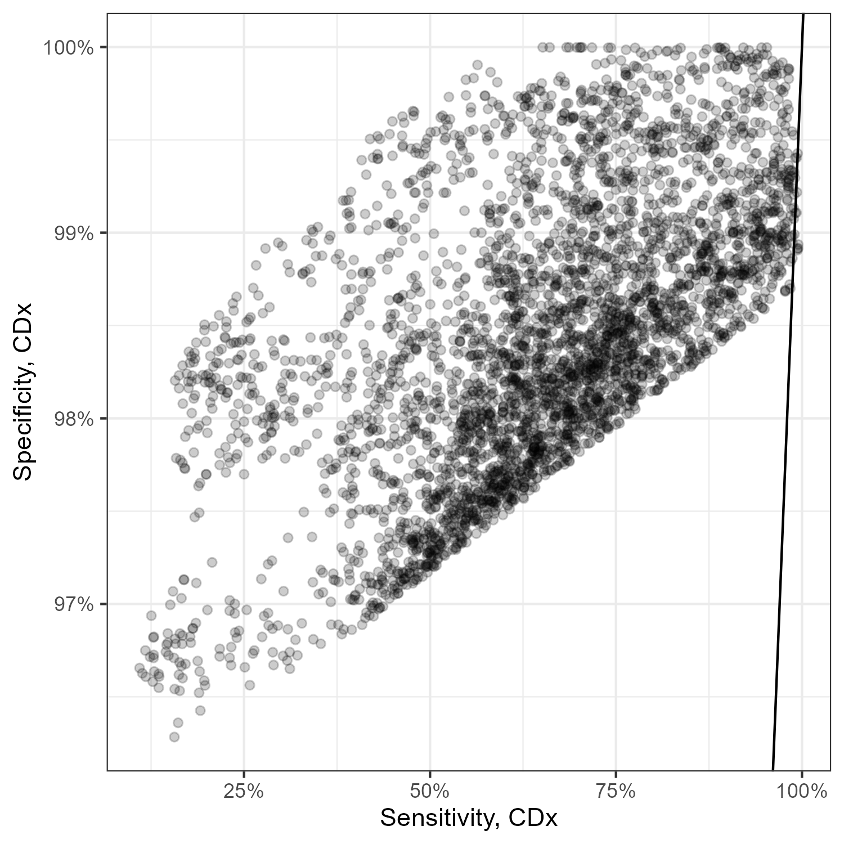
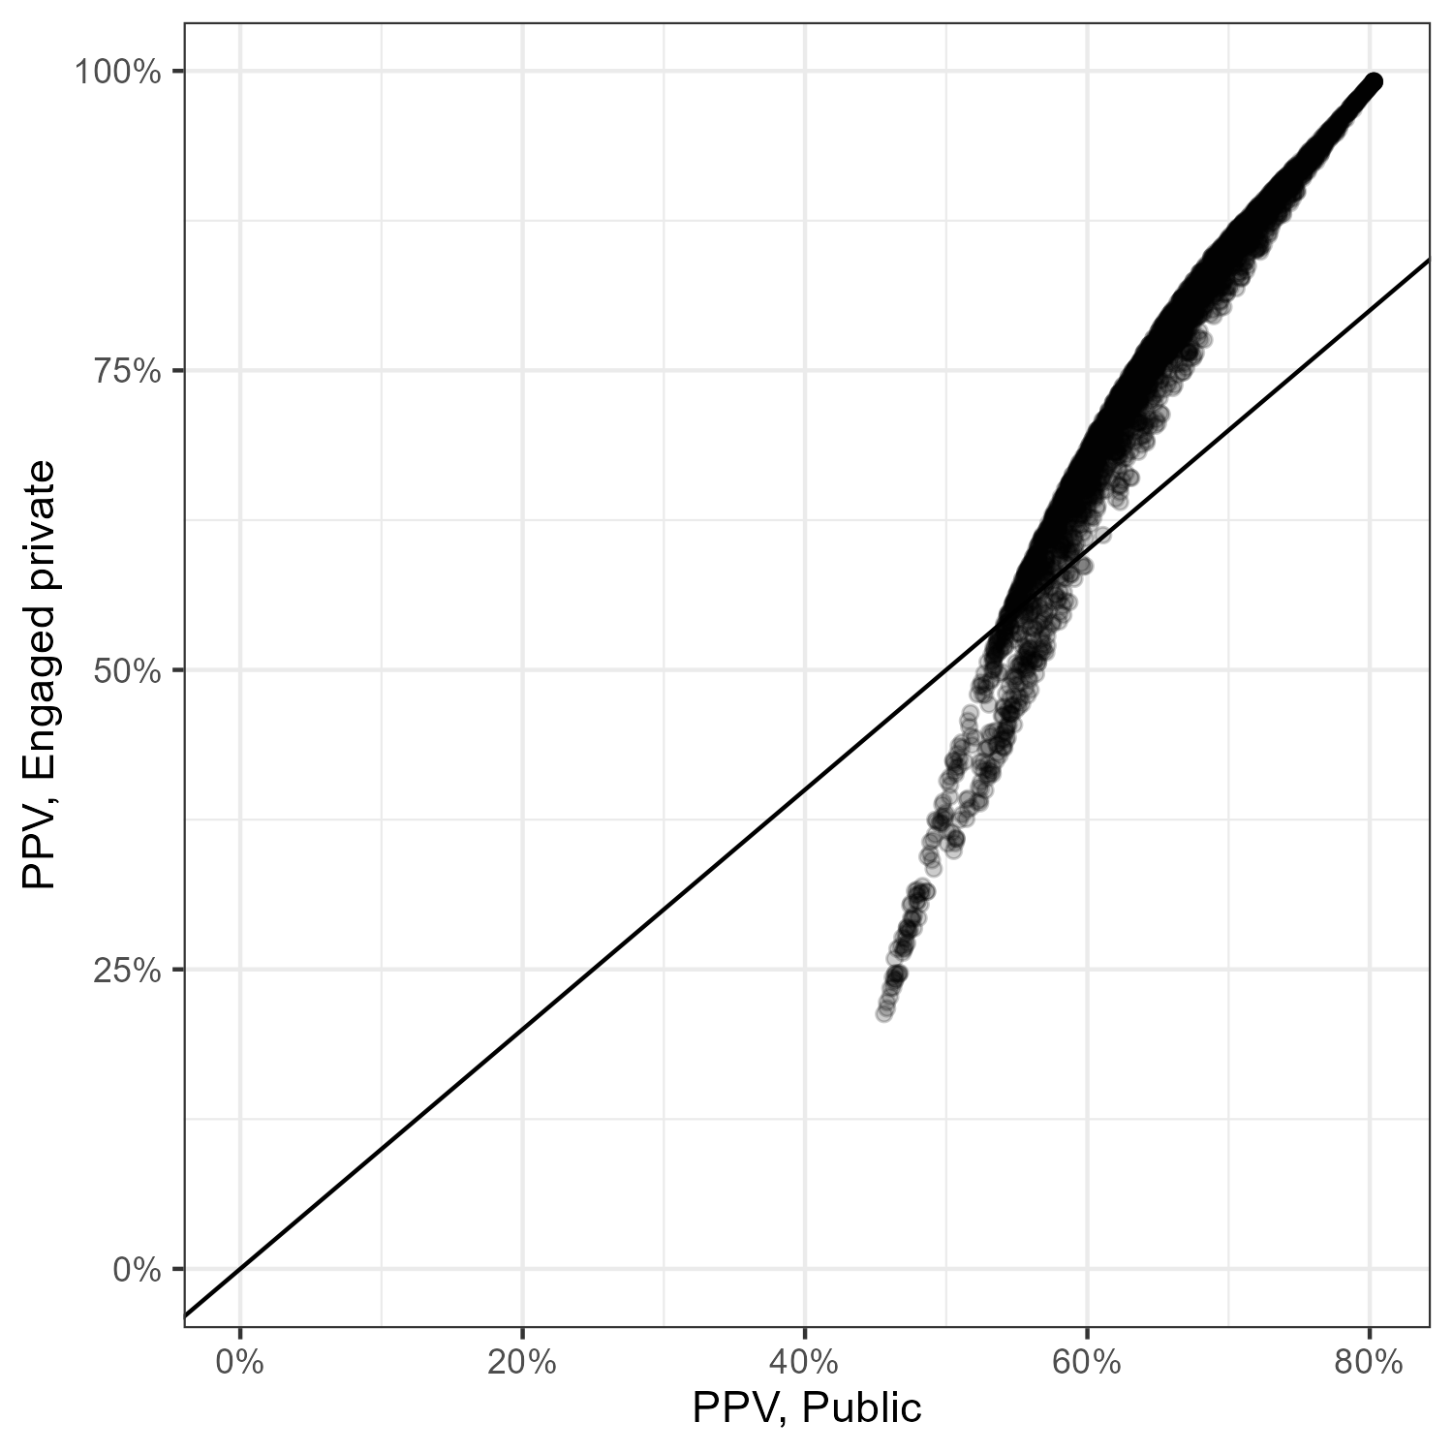
Other indicators
Estimates | Sub group
PPV | Public | 64% (52%-79%)
 | Engaged | 74% (41%-96%)
 | Unengaged | 75% (40%-97%)

Slide 18
Information flow

Slide 19
Step 1: pr(TB|presumptive TB)
Data:
Presumptive cases tested by SSM (Table 1.1)
Case detection by SSM (Table 1.2)
Sensitivity/Specificity of SSM (WHO guideline)
Generated information
Proportional presumptive cases with active TB
Number of SSM-

Slide 20
Step 2: number of Bac-
Data:
Presumptive cases tested by NAAT (Table 1.1)
Case detection by NAAT (Table 1.2)
Sensitivity/Specificity of NAAT (WHO guideline)
Generated information
Number of Bac-

Slide 21
Step 3:
Data:
NAAT performed in the engaged private system (Table 4.2, 4.3)
Case detection by engaged private/public systems (Table 1.2)
Generated information
Case detection by (public, engaged private) X (Bac, CDx)
Presumptive cases with bac tests by (public, engaged private)

Slide 22
Step 4:
Exogenous parameters
Sensitivity/Specificity of clinical diagnosis
Distribution of pathways by public/engaged private
Generated information
Number of care-seeking episodes starting without bac tests
PPVs by public / engaged private / unengaged private systems

Slide 23
Step 5: extended drug-sale analysis
Data:
Initial care-seeking visits by public/private (48.3% from the TBPS2019)
Drug-sale data
Proportional Bac+ within those on ATT by public/private (TBPS2019)
Treatment initiation, public/engaged private (%, Table 3.1, 3.2)
Exogenous parameters:
Treatment duration in the unengaged private
Treatment initiation in the unengaged private
Generated information
Presumptive cases/ case detection / treatment initiation in the unengaged private

Slide 24
Data from India TB report 2023 (link) 2023 as an example while 2021-2023 reports were used
Data | Source | Value in 2023
Presumptive cases tested by SSM | Table 1.1 | 13914911 4120552
Presumptive cases tested by NAAT | Table 1.1 | 4120552
Case notified by Bac+ | Table 1.2 | 1062031
Case notified by CDx+ | Table 1.2 | 1873140
Case notified, public | Table 1.3 | 1688427
Case notified, private | Table 1.3 | 733694
NAAT in private sector / Total NAAT performed | Table 4.2 4.3 | (215594 + 262160) / (3483130 + 2365739) = 0.082
Data from Private sector in Nikshay are “Engaged private sector”

Slide 25
Notes

Slide 26
Caveat
There is no data to connect “Present for diagnosis” and “Intend to test for TB”
The estimates here are only for TB test intentions but not TB care-seeking cascade because
A person with TB can seek care multiple times until treatment initiated
A person with TB might die between care-seeking visits

Slide 27
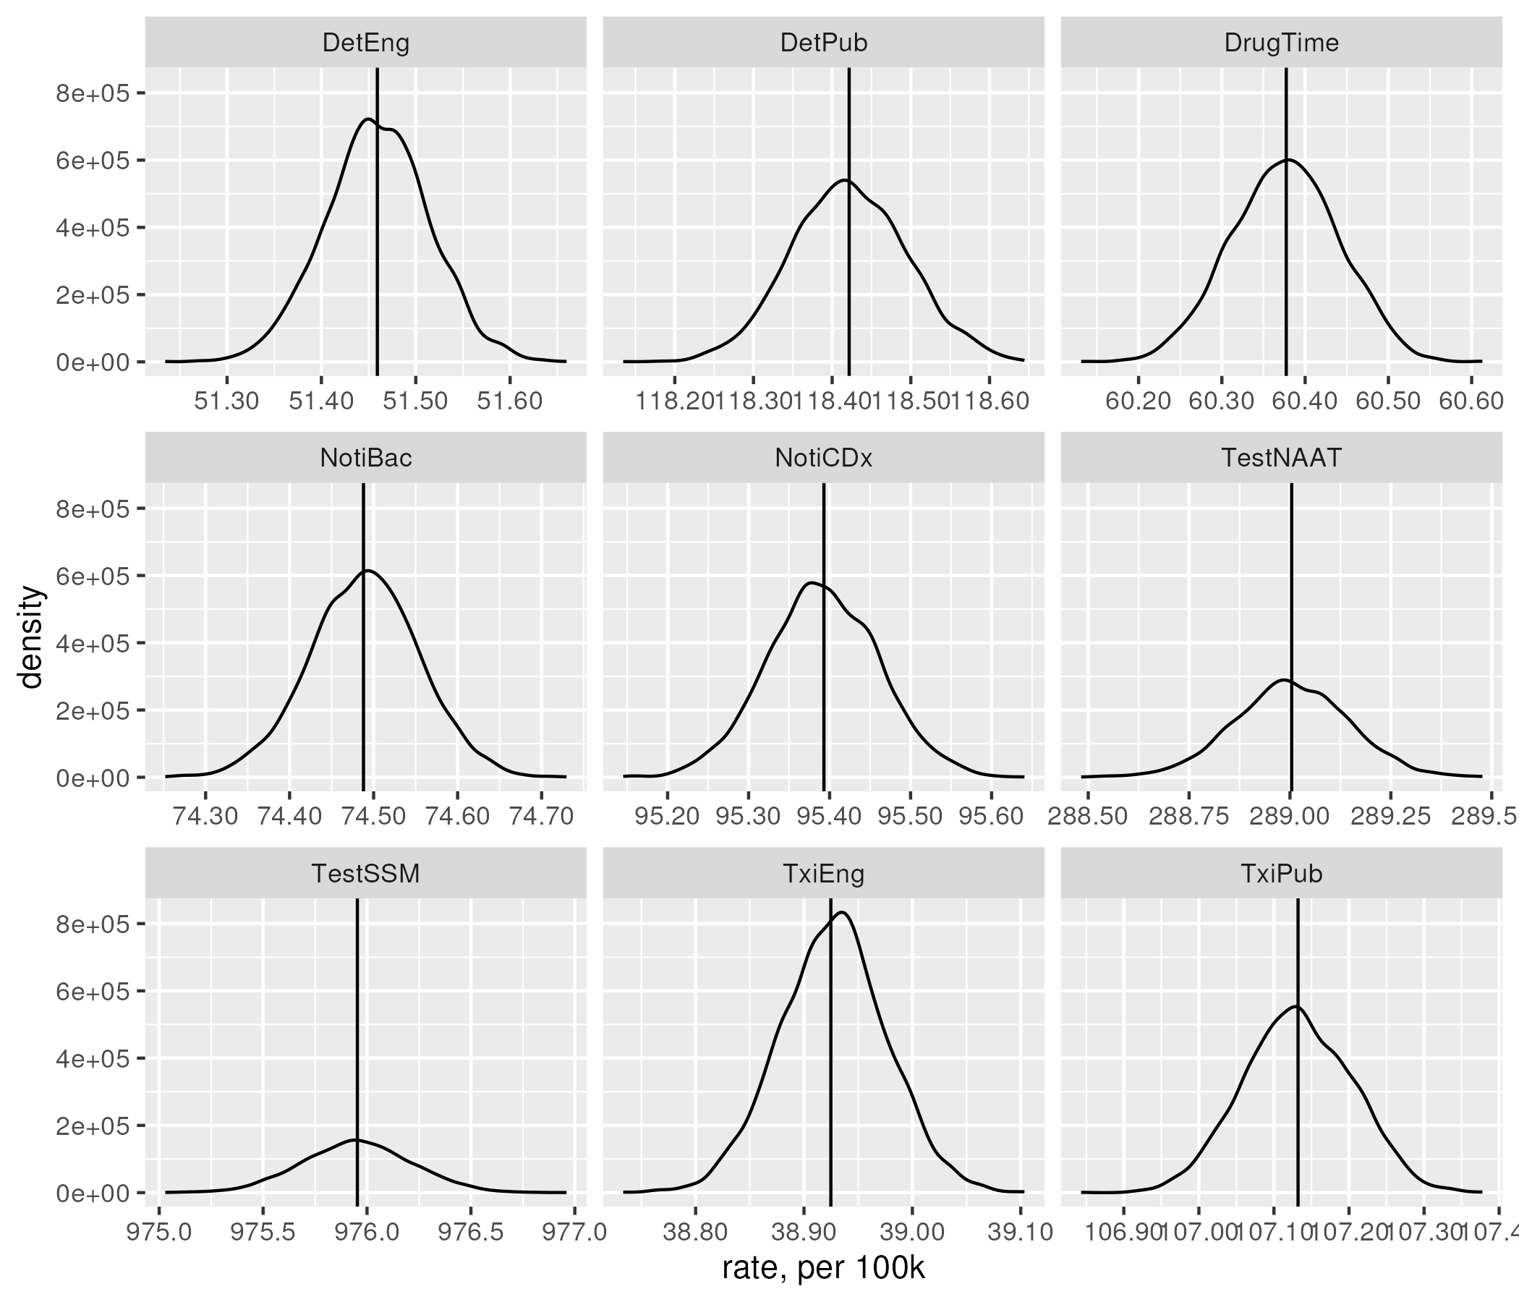
Goodness of fit
Det/Noti: case notification
Txi: treatment initiation
Pub: public sector
Eng: engaged private sector
Bac: microbiological confirmed
CDx: clinically diagnosed
DrugTime: private drug provision per 100k person-year

Slide 28
Prob. Sample collection failure
Two types of test available, prob of failure are p1, p2 respectively
Same specimen type (p1=p2): p(failure) = p1
Different specimen type: p(failure) = p1 + first negative * p2

Slide 29
Present for diagnosis
P1%
Intend to test for TB
P2%
Microbiological test
Test+: P3%
Treatment attempts
P6%
Treatment initiation
Test-: P4%
1-P6%
Test unavailable: (1-P2)%
P5%
Clinical Dx
P5%
Pre-treatment LTFU
With MTB
(TP detection)
(1 - P1)%
1-P5%
Fail to collect
sample: (1-P3-P4)%
Non-TB diagnosis
Clinical Dx
1-P5%
Non-TB diagnosis
Pre-diagnosis LTFU
Present for diagnosis
P1%
Intend to test for TB
P2%
Microbiological test
Test+: P3%
Treatment attempts
P6%
Treatment initiation
Test-: P4%
1-P6%
P5%
Test unavailable: (1-P2)%
Clinical Dx
P5%
Pre-treatment LTFU
Without MTB
(FP detection)
(1 - P1)%
1-P5%
Fail to collect
sample: (1-P3-P4)%
Non-TB diagnosis
Clinical Dx
1-P5%
Non-TB diagnosis
Pre-diagnosis LTFU

Slide 30










Microbiological test
Intend to test for TB
Microbiological test
Notification/
Treatment attempts
Present for diagnosis
$$P_{1}$$
$$P_{2}$$
Microbiological test
Test positive: $P_{sample} P_{3}$
Initiated: $P_{5}$
Treatment initiation
Fail to collect sample: ${1−P}_{sample}$
Test negative:${ P}_{sample}(1−P_{3})$
Positive: $P_{4}$
$${1−P}_{5}$$
Pre-treatment LTFU
Clinical Dx
Negative: ${1−P}_{4}$
Test unavailable/unutilised: $(1−P_{2})$
Fail to suspect TB: $(1 − P_{1})$
Non-TB diagnosis

Slide 31










Microbiological test
Microbiological test
Microbiological test
$$P_{2}$$
Test positive
$$P_{SSM}{(1−P}_{CBN})$$
Sample
$$P_{sample, SSM}$$
SSM
Test negative
Fail to collect sample
$${1−P}_{sample,SSM}$$
Test positive
$$(1−P_{SSM})P_{CBN}$$
Sample
$$P_{sputum,CBN}$$
CBNAAT
Test negative
Fail to collect sample
$${1−P}_{sputum,CBN}$$
Test positive
$$P_{SSM}P_{CBN}$$
Sample
$$P_{sample,SSM}$$
SSM
CBNAAT
Test negative
Fail to collect sample
$${1−P}_{sample, SSM}$$
*Test unavailable: $(1−P_{SSM}){(1−P}_{CBN})$

